Slide 1
EXCELLENT Trial
The Randomized Comparison of Six-Month versus 12-Month Duration of Dual Antiplatelet Therapy after Implantation of DES: From A Comparison of EES versus SES for Coronary Revascularization (EXCELLENT) Trial
Study Design
Randomized
Prospective
Open-label
Noninferiority
Subject Characteristics
Mean age 63 years
One-third women
About 40% diabetic
>99% on aspirin and clopidogerel; >80% on statins; >50% on beta blockers; about 33% on ACE inhibitors
Primary Endpoint
Target vessel failure (TVF) at 12 months

Slide 2
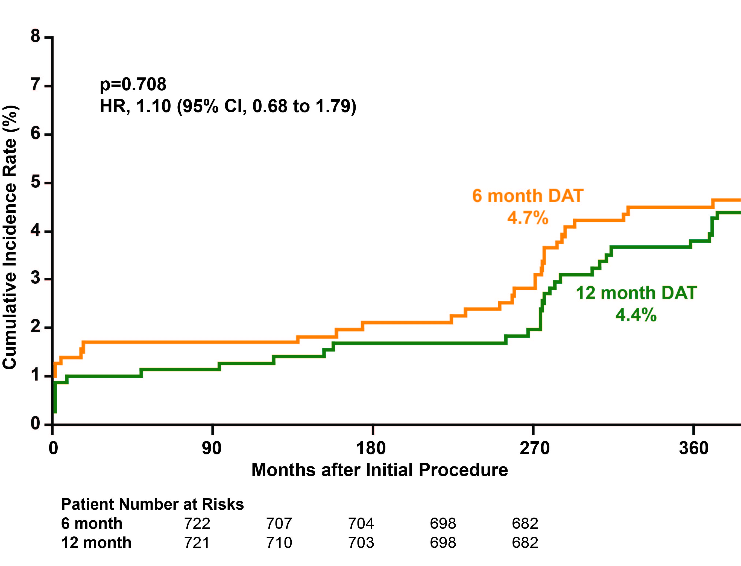
EXCELLENT Trial
Results
No significant difference in TVF at 12 months
p=0.43 (superiority)
p=0.0031 (noninferiority)
Significant association (p<0.001) between the presence of diabetes and less favorable results with 6 months of dual antiplatelet therapy (p=0.005)
Conclusion
More data are needed from larger appropriately powered trials before
any changes to clinical practice can be recommended.

