Slide 1
Target Study
Targeted Left Ventricular Lead Placement to Guide
Cardiac Resynchronization Therapy in Patients with HF:
A Randomized Prospective Study (Target Study)
Background
Cardiac resynchronization therapy (CRT) is an established treatment for advanced heart failure symptoms, impaired LV systolic function, and intraventricular conduction delay
30-40% patients fail to gain significant clinical benefit
LV lead position has emerged as an important determinant of response

Slide 2
Target Study
Hypothesis
That targeted lead placement to the site of latest contraction and away from areas of scar would enhance CRT response when compared to usual (unguided) treatment
Study Design
Prospective
Single-blind
Randomized
Controlled
Primary Endpoint
>15% reduction in left ventricular end systolic volume (LVESV) at 6 months

Slide 3
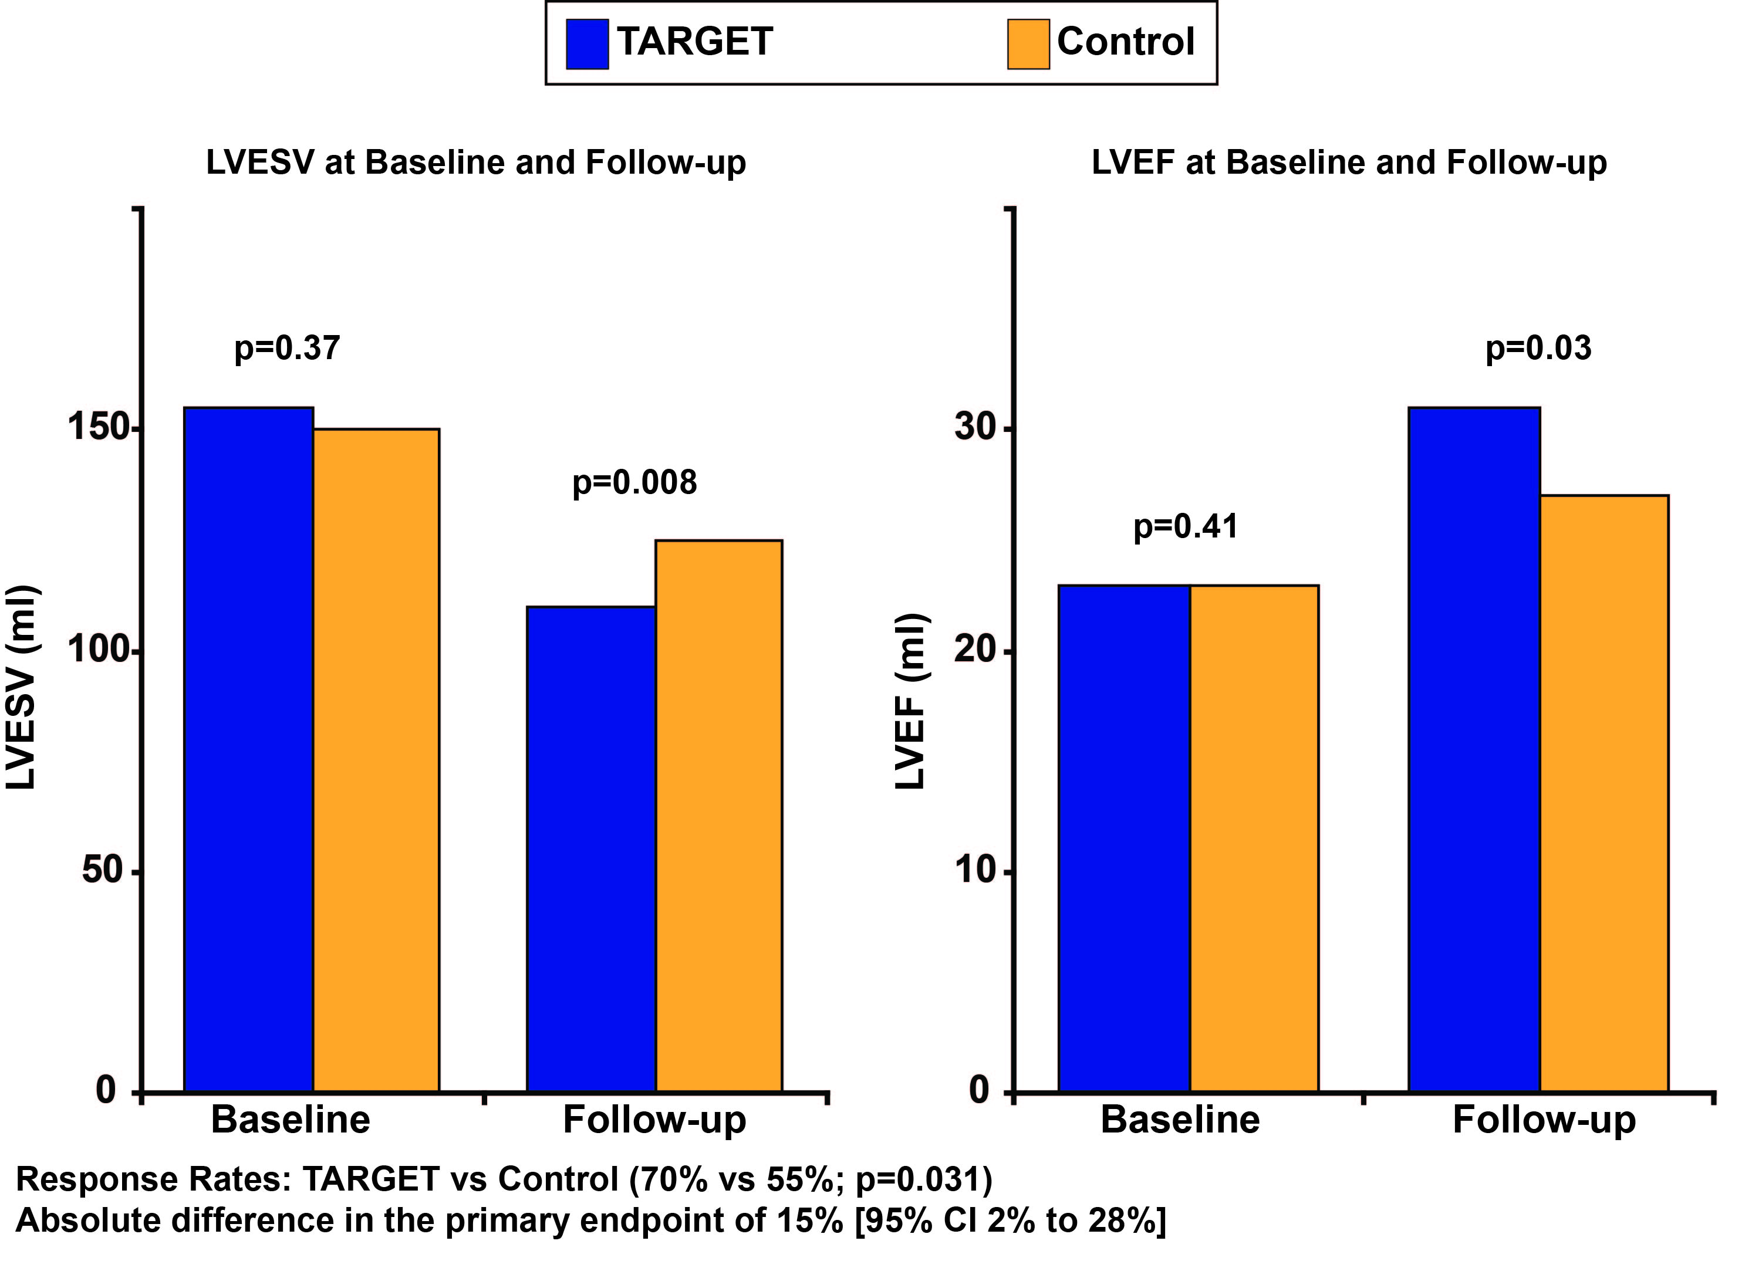
Target Study
Primary Endpoint
Response Rates: TARGET vs Control (70% vs 55%; p=0.031)
Absolute difference in the primary endpoint of 15% (95% CI, 2% to 28%)

Slide 4
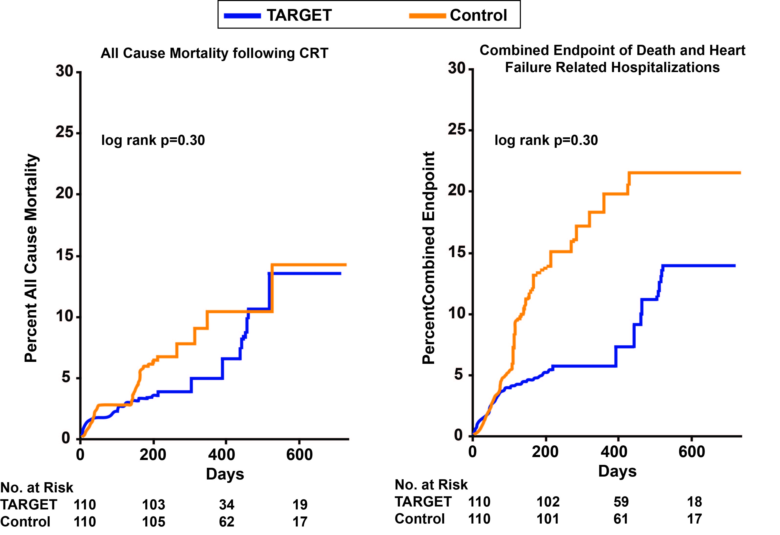
Target Study

