Slide 1
RAPS
Radial Artery and Saphenous Vein Patency More Than 5 Years Following CABG Surgery: Results from the Randomized Multicenter Radial Artery Patency Study
Objective
To compare the angiographic patency of radial-artery grafts with that of saphenous-vein grafts (SVGs) 8 to 12 months post surgery
Study Design
Randomized, Multicenter
Within patient randomization of grafts (each patient had both a radial artery graft and a SVG)
561 patients, 440 with angiographic follow-up
Primary Endpoint
Total occlusion at 1 year

Slide 2
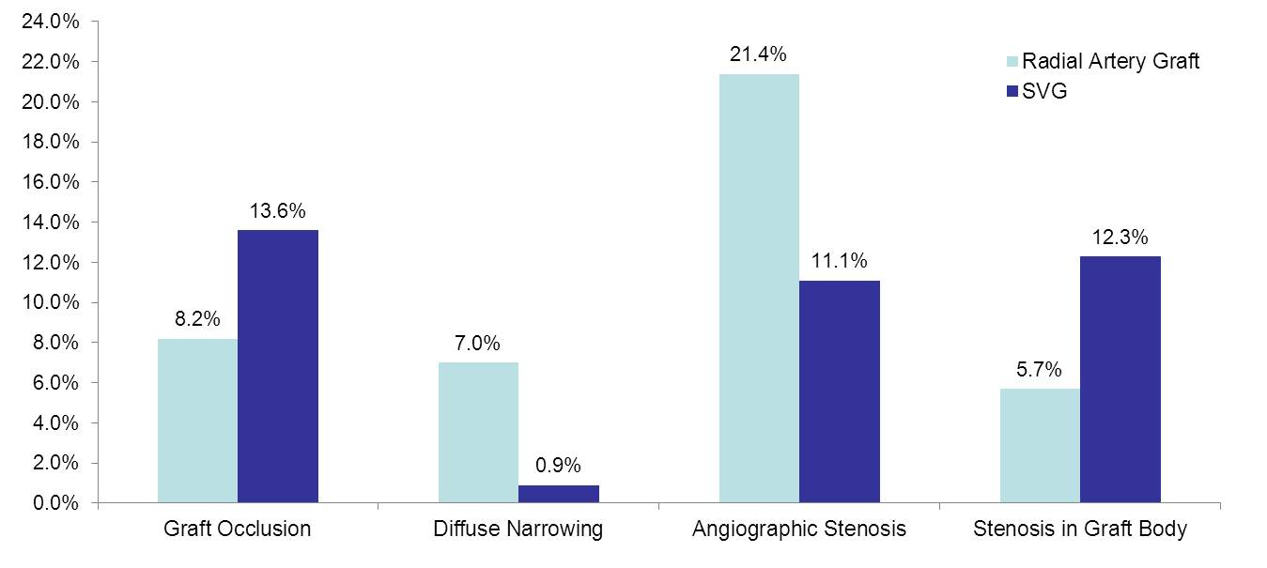
RAPS
1-Year Results
p=0.009
p<0.001
p=0.003
p=0.001
No significant differences at distal anastomosis or in perfect graft patency

Slide 3
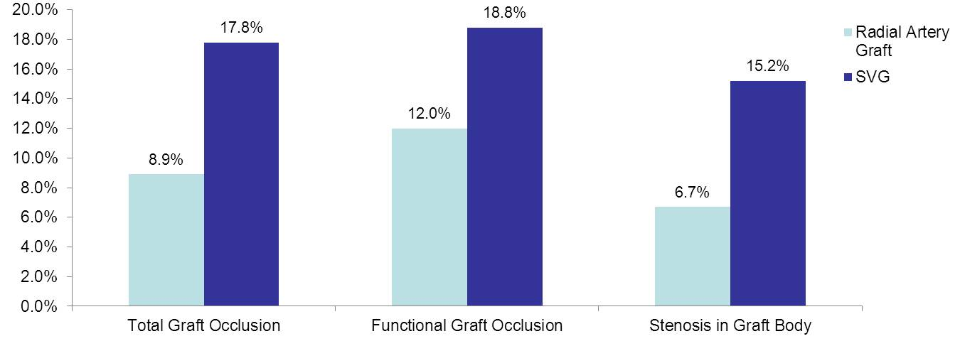
RAPS
5-Year Results
p=0.05
p=0.004
p=0.02
Conclusion
Overall the study showed reduced rates of both functional and total graft occlusion as well as less graft disease with radial artery grafting compared with SVG

