Slide 1
PLATINUM
A Prospective, Randomized, Investigation of a Novel Platinum Chromium Everolimus-Eluting Coronary Stent: The PLATINUM Trial
Objective
To evaluate the clinical outcomes of a novel platinum chromium everolimus-eluting stent (PtCr-EES) compared with a predicate cobalt chromium everolimus-eluting stent (CoCr-EES) in patients undergoing percutaneous coronary intervention (PCI)
Background
Identical antiproliferative agent and polymer as CoCr-EES
Novel platinum chromium scaffold

Slide 2
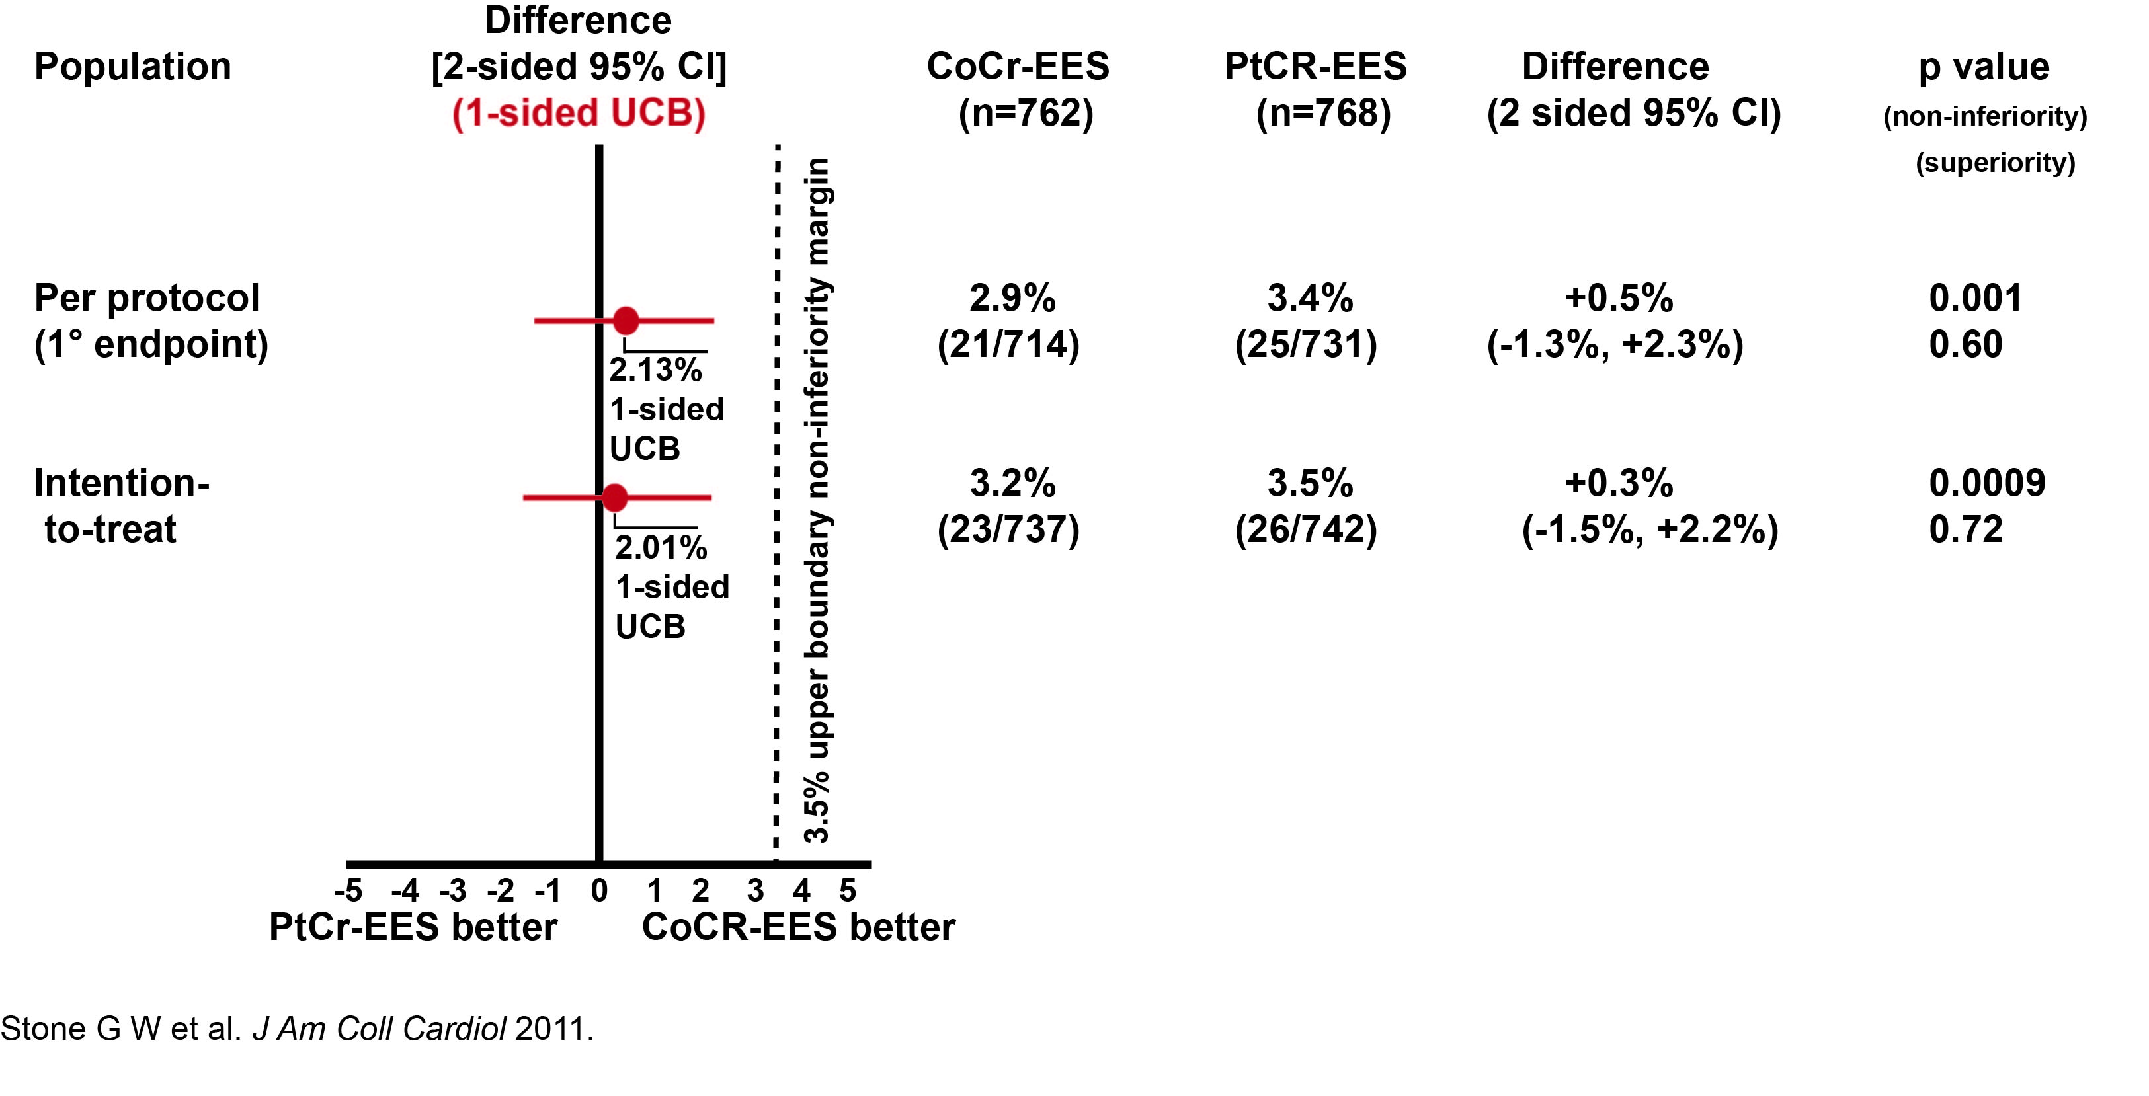
PLATINUM
Results
Primary Endpoint of target lesion failure 2.9% for CoCr-EES versus 3.4% for PtCr-EES (difference: 0.5%; 95% CI, -1.3% to 2.3%)
p(noninferiority)=0.001
p(superiority)=0.60
Journal of the American College of Cardiology by AMERICAN COLLEGE OF CARDIOLOGY. Reproduced with permission of ELSEVIER INC. via Copyright Clearance Center. http://www.sciencedirect.com/science/journal/00029149

Slide 3
PLATINUM
Results cont.
Results were similar in the intention-to-treat analysis: 3.2% (23/737) of the CoCr-EES versus 3.5% (26/742) of the PtCr-EES group (risk difference +0.3%, 95% CI, -1.5% to 2.2%; p for noninferiority=0.0009)
TLR and stent thrombosis rates were very rare and occurred equally with both stents (1.9% and 0.4%, respectively)
Conclusion
Findings indicate that platinum chromium may now be considered an acceptable metal alloy for use in drug-eluting stents
Nonsignificant differences in measures of safety and efficacy through 12-month follow-up after PCI
Event rates were less than expected (and similar to the number that was lost to follow-up); thus, while statistical noninferiority was demonstrated, small differences between the stents can not be excluded
Longer-term follow-up and additional multicenter studies are indicated in patients with acute coronary syndromes and/or complex coronary anatomy to further assess stent deliverability and clinical outcomes in these important patient populations.

Slide 4
PLATINUM
Conclusion
Nonsignificant differences in measures of safety and efficacy through 12-month follow-up after PCI
Findings from PLATINUM indicate that along with stainless steel and cobalt chromium, platinum chromium may now be considered an acceptable metal alloy for use in drug-eluting stents. Of note, however, the event rates were less than expected (and similar to the number that was lost to follow-up); thus, while statistical noninferiority was demonstrated, small differences between the stents can not be excluded. Longer-term follow-up and additional multicenter studies are indicated in patients with acute coronary syndromes and/or complex coronary anatomy to further assess stent deliverability and clinical outcomes in these important patient populations.

