Slide 1
PARTNER
The Transcatheter versus Surgical Aortic Valve Replacement in High Risk Patients with Severe Aortic Stenosis: The PARTNER Trial
Objective
To compare surgical aortic valve replacement (AVR) with transcatheter aortic valve replacement (TAVR) in high-risk patients with severe stenosis
Study Design
Multicenter, randomized
358 patients with severe aortic stenosis who were considered unsuitable candidates for surgery to standard medical therapy or transfemoral transcatheter implantation of a balloon-expandable bovine pericardial valve
Primary Endpoint
1-Year mortality rate from any cause

Slide 2
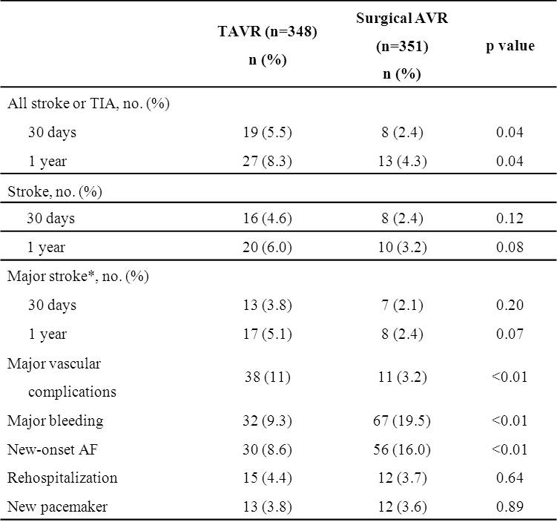
PARTNER
Secondary Endpoints
Results
1 year mortality 26.8% for AVR group vs 24.2% for TVR (HR, 0.93; 95% CI, 0.7 to 1.22; p=0.001 for noninferiority, p=0.62 for superiority)
30-day neurological events were significantly higher in TAVR vs AVR groups (stroke or TIA, 5.5% vs 2.4%; p=0.04)
1-year neurological events significantly higher in the TAVR group vs AVR (stroke or TIA, 8.3% vs. 4.3%; p=0.04)
TAVR=transaortic valve replacement; AVR= aortic valve replacement; TIA=trans ischemic attack Defined as Rankin Score >2; this was a post hoc analysis.

Slide 3
PARTNER
Conclusions
The PARTNER trial is a groundbreaking study in the minimally invasive management of valvular heart disease, with the potential to change the standard of practice within cardiology
If preliminary results can be replicated with similar clinical effectiveness in routine practice, then transcatheter surgical AVR may be an acceptable alternative therapy to surgical AVR for high-risk patients in the near future
The significance of the trade-off between adverse events that are associated with TAVR versus surgical AVR short and long term requires further exploration

