Slide 1
ISAR-CABG
Long-Term Outcomes After Use of DES and BMS for the Treatment of Saphenous Vein Graft Lesions: Results of the Randomized ISAR-CABG Trial
Objective
To compare the efficacy of DES with BMS in a randomized trial powered for clinical events
Sample
610 patients with de novo SVG lesions
Participants had ischemia symptoms or evidence of myocardial ischemia in the presence of ≥50% de novo stenosis located in SVGs
Approximately 40% of patients had moderate to severe SVG degeneration
Exclusion criteria included cardiogenic shock, target lesions in arterial grafts, malignancies with <1 year of life expectancy, or allergies to study medication
Primary Endpoint
A composite of death, MI, or ischemia-related TLR at 1-year post index PCI
Secondary Endpoints
All-cause mortality, MI, ischemia-related TLR, or incidence of definite or probable stent thrombosis

Slide 2
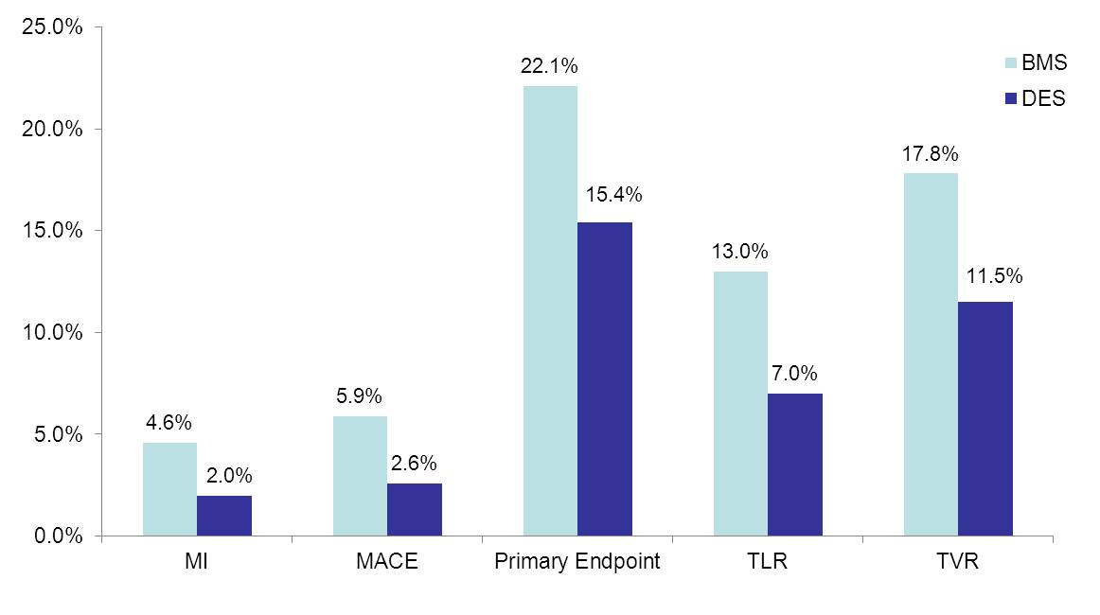
ISAR-CABG
30 Day Outcomes
p=0.03
p=0.03
p=0.02
p=0.05

Slide 3
ISAR-CABG
Conclusions
Outcomes show that DES are associated with lower rates of MACE compared with BMS for SVG lesions
These results are driven largely by a reduced need for revascularization, and there were no significant differences in death or stent thrombosis between groups
Findings are supportive of those that are found in the long-term follow-up of the SOS trial, which showed that the use of paclitaxel-eluting stents was associated with significantly better clinical outcomes than BMS in SVG lesions (NCT00247208) [Emmanouil S et al. J Am Coll Cardiol Cardiovasc Interv 2011]

